Slide 1
Insights and Inspiration 17/08/2023
CWB AWARDS 2023
Version 1.0

Slide 2
INTRODUCTION
Canberra Women in Business (CWB) is a not-for-profit incorporated association supporting women in business in the Canberra region.
Founded in 1992, CWB (formerly the Chamber of Women in Business) was created by women and run solely for women, to provide support and development opportunities for local businesswomen.
Each year, our CWB Awards recognise and reward the valuable contributions and outstanding achievements of business women across the Canberra region.

Slide 3
AWARDS SPONSORS
2023

Slide 4
AWARD CATEGORIES
·Business Woman of the Year
·Small Business Woman of the Year
·Micro Business Woman of the Year
·Young Business Woman of the Year
·Indigenous Business Woman of the Year
·Innovation Business Woman of the Year
·Social Impact Business Woman of the Year

Slide 5
KEY DATES FOR AWARDS
Applications open Monday 4 September
Applications close MIDNIGHT Friday 29 September
Finalists announced Thursday 19 October
Winners announced at Gala Dinner Friday 27 October

Slide 6
WINNERS RECEIVE
a framed commemorative certificate,
a trophy,
permission to display the Synergy Group CWB Awards winner logo,
Canberra Weekly cover and editorial, and
inclusion in press releases,
promotion on the CWB website,
exclusive Invitation to Keynote present at the Women’s Entrepreneurship Day Event (November)
opportunities to host or present workshops / keynotes / panel members at CWB events.
I

Slide 7
ELIGIBILITY CRITERIA
You are a business owner, manager or work in an organisation, department or company
You reside and work in the ACT or surrounding region
You are an Australian resident over 18 years of age
You are not serving on the CWB committee
You have not previously won the award for the category in which you are entering
You are not on the judging panel and have not been involved in the judging in the past 2 years
I

Slide 8
ELIGIBILITY CRITERIA
If entering the Young Business Woman Award you are 30 years old or under
If entering the Small Business Woman of the Year Award you have 20 or fewer employees
If entering the Micro Business Woman of the Year Award you have 1-4 employees maximum (this category includes women who work by themselves and have no employees)
For Innovation and Social Impact Categories, you are a business owner, manager or work in an organisation, department or company
For Small Business, Indigenous Woman, Young Business Woman and Business Woman of the Year categories, you must be the business owner of the associated business nominated.

Slide 9
RULES - KEY POINTS
Entry is open to all CWB members and non-members
Entry for CWB Members is free
Non-members of CWB are welcome to enter for an entry fee of $150 for each category. The entry fee must be paid for each category entered.
Eligibility for entry is dependent on the award category and may be open to businesses, organisations and/or individuals
Entry to multiple award categories is allowed

Slide 10
RULES - KEY POINTS
Young Business Woman of the Year entrants MUST provide a copy of a ‘Proof of Age’ document or the submission will be disqualified
Business Woman of the Year, Young Business Woman of the Year, Indigenous Business Woman of the Year, Small Business Woman of the Year and Micro Business Woman of the Year entrants MUST submit financial documentary evidence or the submission will be disqualified
Supporting documents and photographs must be provided with your entry and clearly labelled
All information collected is handled with the upmost respect and privacy in line with CWB Privacy policy which can be found here: The Formalities | CWB
All entrants will be provided a nominee badge to share on their social media and website.

Slide 11
APPLICATION FLOWCHART

Slide 12
BENEFITS OF ENTERING
validate your hard work, purpose and creativity
recognition for your business and leadership skills
positive exposure for your business/organisation
network and meet other great business women
helps the positive reputation of your business
be amongst Canberra's female business leaders

Slide 13
TIPS FOR APPLICATIONS
ensure your application is clear, concise, well structured and written in the first person
use headings, dot points, short sentences, white space
use examples and backup with evidence e.g. stats/data, testimonials
provide all required documentation
ensure you enter the correct category/ies

Slide 14
REFLECTION...
what is your business journey? How do you tell YOUR story?
what are some of your business milestones?
what challenges have you overcome? How did you overcome them?
what makes your business different to others in your industry?
what are some of your main achievements?

Slide 15
REFLECTION...
what benefits do you bring to your clients?
what impact does your business or innovation make?
how has your business grown? What evidence can you supply?
what connections do you have with the local community?

Slide 16
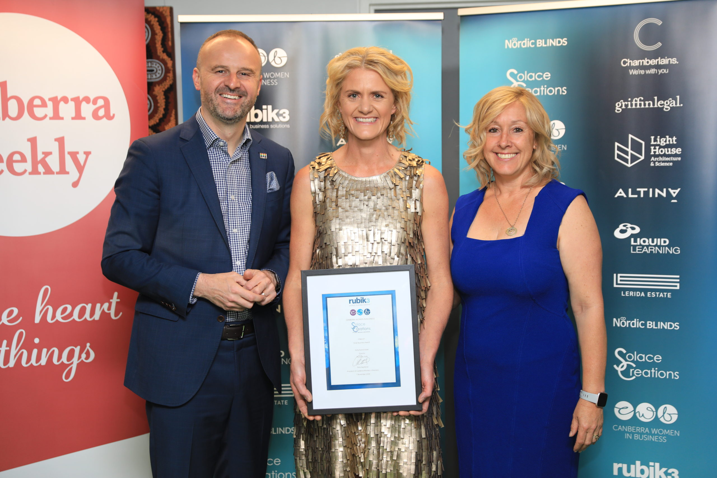
CONTACT
www.cwb.org.au
office@cwb.org.au
newsletter for members
become a member - www.cwb.org.au/membership

